Slide 1

Understanding California’s
New Testing System
An Overview
March 2015
Notes:
Good evening and thank you for being here tonight to learn more about the new tests that your child will be taking this spring.

Slide 2

Overview of the Presentation
What is the new testing system?
Why is it necessary?
What do the new tests measure and how?
How can I help my child prepare?
Where can I go for more information?
Notes:
Before we get started I wanted to give you a sense of what kind of information I’ll be sharing tonight.
California is undergoing some major changes in the way the state provides money to schools and in many things that go on within the classrooms as well.
Tonight we are going to tackle several different questions about the new testing system in California – many of them are listed on this slide.
We have a lot to cover so let’s get started….

Slide 3
California State Testing Programs
CELDT
PE Testing
CAASPP
CAHSEE
Grades 3-8 & 11
& Grades 5, 8, 10 Science
Grades 5, 7 & 9
Replaces previous
Standardized
Testing and Reporting
(STAR) Program
Grades 10, 11 &12
English Learner Students
Notes:
California’s testing system includes many different pieces.
Most of the pieces are unchanged like Physical Education testing, the California High School Exit Exam which is a requirement of high school graduation, and the California English Language Development Test or CELDT that is given each year to students who speak English as their second language.
The new program, depicted in the darker blue portion of this pie, is called the California Assessment of Student Performance and Progress or CAASPP. [Click]
And it replaces the testing program from the past called the STAR Program.
Now let’s talk a little more about the CAASPP system.

Slide 4
California Assessment of Student Performance and Progress (CAASPP)
Science
Grades 5, 8 & 10
Paper-based
English-Language Arts & Math
Computer Adaptive Test (CAT)
Wider range of test questions
Multiple-choice test questions
California Standards Tests (CSTs)
Smarter Balanced Tests – NEW!!
Grades 3-8 & 11
Aligned to old standards; will be replaced soon
Aligned to new standards
Notes:
[Click] Currently the CAASPP system includes tests in science [Click]
And in English-language arts, and mathematics.
Other subject areas will be added over time.
Let’s talk a little more about the science tests [Click]
Students in grades 5, 8, and 10 are tested each year in science. The science tests are still aligned to the old standards and are paper and pencil, multiple-choice tests. They will be replaced in a couple of years with new computer tests aligned to the new science standards called the Next Generation Science Standards.
[Click] The tests in English-language arts and mathematics that students will take this year are also called the Smarter Balanced tests.
These tests were developed by many states working together with experts in K-12 education, community colleges, 4-year colleges and universities, and experts in the workforce. They are designed to measure higher level skills that we’ll talk about in a few minutes.
Students take these tests on the computer and the tests include a variety of types of questions.

Slide 5



Highlighting the Differences
Old System
New System
WHAT
Content Standards for California Public Schools
HOW
ITEM TYPES
Multiple Choice
Short Answer
Drag and Drop
Hot Spots
Graphing
Essay
Multiple Choice
Essay
Notes:
So why do we have these new tests? There have been some major shifts in California education over the last few years…
First, there is the “What”
We have new standards
In 2010, California adopted the Common Core State Standards
New standards have more rigorous expectations for students – they set a higher bar for success.
Designed to ensure success in college, career, and life.
Developed with input from higher education and workforce leaders.
Emphasize critical thinking, analytical writing, and problem solving skills.
Next there is the “How”
We are testing in a new platform…on technology
All students will be taking these tests on a computer.
[Insert information about what type of computer set-up you have in your district HERE – i.e. as most of you know, our district has been investing heavily in technology over the last two years and have purchased Chrome book carts for at least every grade level at school. Our students are using technology in the classroom more than ever before and our teachers are spending time with students on the Smarter Balanced practice tests that I’ll tell you more about later in this presentation.]
Tests are computer-adaptive meaning that the difficulty of the questions adjusts based on the answers students give.
Unlike paper and pencil tests where every student received the exact same test with the exact same questions, these online tests give different experiences for different students.
As students answer questions correctly, they receive more challenging questions.
Incorrect questions trigger easier questions.
This feature of the new tests keep students engaged, shortens testing time for many students, and provides more accurate results.
And finally, there are new “Item Types”
We will be using multiple items types…not just Multiple Choice
Some questions will be multiple choice but others will require students to type their answers, to drag and drop things in different parts of the screen, to highlight critical parts of a reading passage, or to draw a graph.
Some questions will have more than one answer.
The questions require deeper thinking – it’s not as simple as choosing between 1 of 4 possible answers.
There are also performance tasks…we’ll talk more about those in a few minutes.

Slide 6
More About the Smarter Balanced Tests
Each subject area has two parts:
  Computer-adaptive items
    English-Language Arts (40-45 items)
    Math (30-35 items)
  Performance Task
    Designed to show how students can integrate knowledge and skills across multiple areas
    English-Language Arts (3 questions)
    Math (6 questions)
Source: Smarter Balanced test blueprints
Notes:
Let’s talk a little bit more about the components of the Smarter Balanced tests.
The majority of items that a student will see are computer-adaptive items. A student will see between 40 and 45 items in English-language arts depending on their grade level and between 30 and 35 items in math, again depending on their grade level.
All students will also participate in one performance task in each subject area.
The next few slides give more information and examples of both computer-adaptive items and performance tasks.

Slide 7
Computer-Adaptive Items
Testing system selects questions that are appropriately challenging for students based on student answers to previous questions.
  When a student gets an answer correct, the next question is more difficult. When a student get an answer wrong, the next question is slightly easier.
  Tailored or customized to the student’s ability level
    No two students will receive the same test whereas under the STAR system, most students all received the same questions. This helps with test security too.
  Helps keep students more engaged
Often takes fewer questions and less time to identify student skills
Notes:
Let’s talk a little bit more about the computer-adaptive items.
In a computer-adaptive testing system the system makes choices about what questions to give to students based on the students’ answers to previous test questions – that’s the “adaptive” quality of the system.
This means that unlike the previous paper and pencil system where most students saw the same test questions, the computer-adaptive test is completely customized to each student’s ability level.
This feature helps keep students engaged with the tests too. Again, under the paper and pencil forms a student who knew all the answers got bored and a student who might have struggled with answering difficult questions gave up.
What’s also nice is that for many students, they will need to answer fewer questions taking less time that the old type of assessments because the new computer-adaptive system is so powerful.

Slide 8
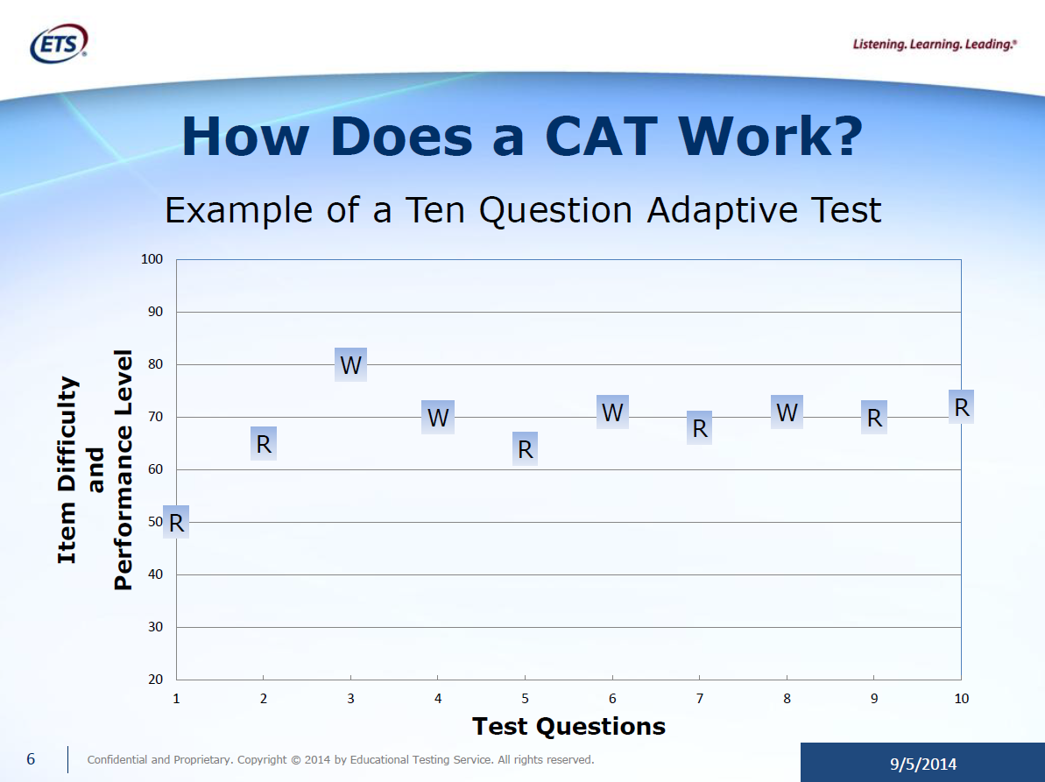
Notes:
Let’s explore a bit more about how the computer-adaptive testing system works.
Up the vertical axis is item difficulty – the higher on the scale you go the more difficult the item
You can see that the first question is at the half way mark – meaning about half of students get the question right and half get it wrong. This is the question that starts the computer algorithm.
This student gets that first question correct so they are presented with another question that is more difficult. The student answers that question correctly and is presented with another more difficult question. The student answers this question incorrectly and you can see then receives an easier question…but a question that is still more difficult that the one they previously answered correctly. And the example goes on from there.

Slide 9
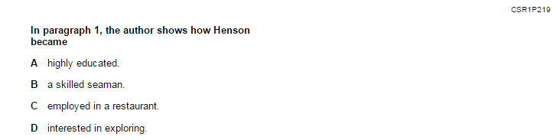
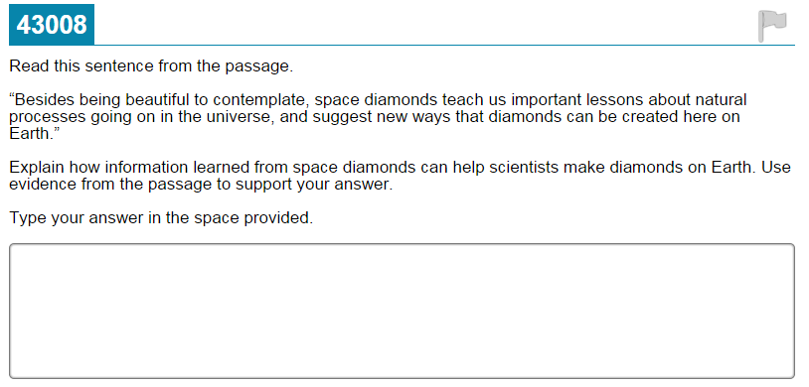
What is Different: English-Language Arts
Notes:
Now let’s look at an example of a test question in English-language arts at the elementary level.
[Click] Under the STAR Program, students were asked to read a passage and then answer a set of questions about what they read. They were always given multiple answer choices.
Compare and contrast that type of question with this question from the new Smarter Balanced English-language arts test [Click]
In this new type of question, the student is asked to read a portion of the passage and use information from the passage to explain an answer to the question.
See how these new questions ask information in different ways making students think more critically about the question and sometimes use multiple source of information in order to find their answer.

Slide 10
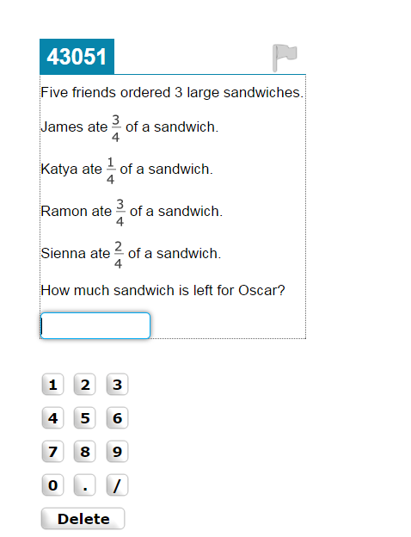
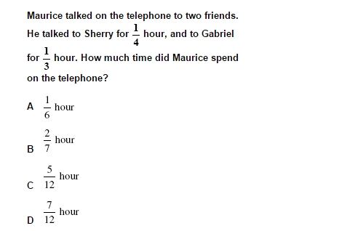
What is Different: Mathematics
Notes:
Here is another example of how test questions are different – this time for math and again an elementary example.
In the question on the left, a student is asked to add two fractions together to represent the total amount of time that Maurice was on the telephone.
The question on the right, also about fractions, is from the new Smarter Balanced tests.
In this question, a student must add fractions together, but then the student must also subtract the sum from the total number of sandwiches to figure out how much is left for Oscar.
Again, still about fractions, but this question asks students to tackle the problem using multiple steps.

Slide 11
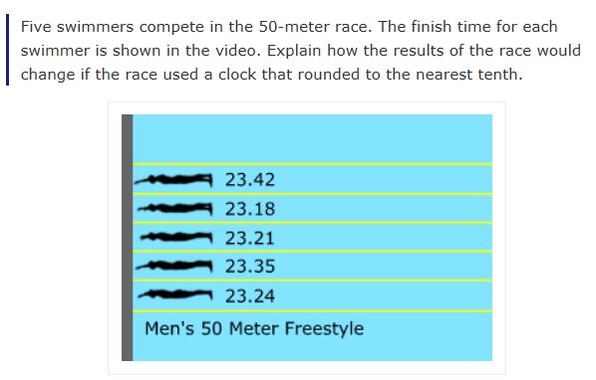
What is Different: Mathematics
Notes:
Here’s another sample question in math – this one is about rounding to different place values.
In the multiple choice question at the top, a student is simply asked to round the value to the nearest thousand square miles and then is presented with four possible answer choices.
In the swimming example – a test question from the new Smarter Balanced tests – it’s still a question about rounding, but there are multiple pieces to it.
The question tells students that five swimmers competed in a race and their times are shown. Then instead of asking a student to round each finish time to the nearest tenth, the question asks the student to tell how the results of the race would change IF the times were rounded to the nearest tenth. In order to answer this question correctly, a student needs to rank the swimmers based on the finish times shown to the hundredth’s place, then round each finish time to the nearest tenth, and then re-rank them based on the rounded finish times to determine if the finish order would have changed.
This is another great example of a test question that makes students think deeper about the answer and they could envision some sort of real-world problem like this that they might have to solve in the future.

Slide 12
What is a Performance Task?
Activity that requires students to use multiple pieces of information to respond to a series of questions on their own (i.e. not multiple choice where the student selects an answer from a set of choices)
Three steps:
  Classroom activity delivered by teacher
  Independent work
  Development of response
The performance tasks are given via the computer, but they are not computer-adaptive; all students in a given grade get the same performance task.
Notes:
Now let’s go back and revisit the second component of the Smarter Balanced tests – the performance task
Each student will take one performance task in each subject area.
But what is a performance task?
A performance task is the assessment term given to a type of activity that requires students to interact with various pieces of information and then prepare a response on their own versus choosing one answer from several different options.
Each performance task starts with a classroom activity delivered by the teacher and then students work independently to research, analyze, and synthesize pieces of information that will help them develop their response to the task.
That is then followed by time for the student to enter their responses into the computer.
Let’s take a quick look at an example of a performance task from the Smarter Balanced Practice Test.

Slide 13
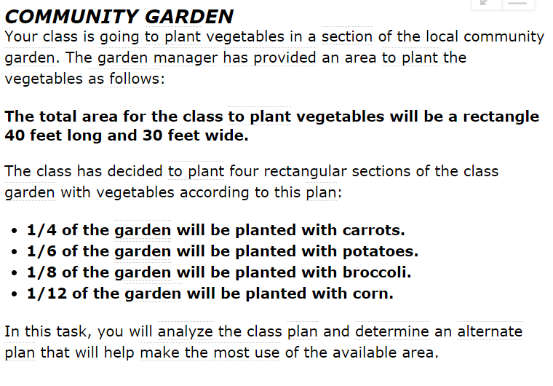
Example of a Performance Task
Smarter Balanced Practice Test; Grade 5 Math - Problem
Notes:
This slide shows a 5th grade math performance task
You can see it’s a scenario about planting a community garden. The “problem” provides information to students about the total size of the garden and then specifies the planting plan for different crops.
Students are then asked a number of questions about this scenario. Let’s see what those questions look like.

Slide 14
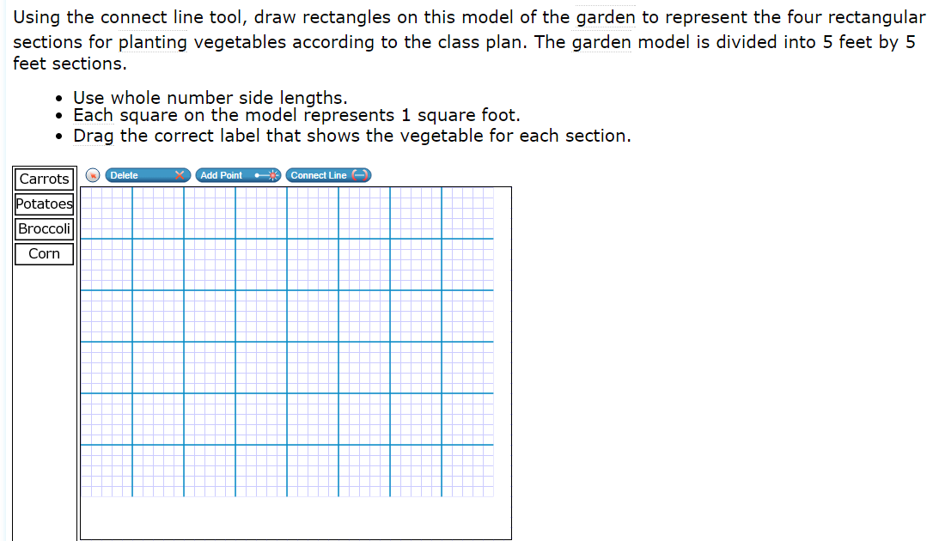
Example of a Performance Task
Smarter Balanced Practice Test; Grade 5 Math – Question 1
Notes:
Here is the first question in the performance task.
The student is asked to draw rectangles to represent the four different crops based on the fractional amounts they can represent in the garden that were specified in the problem in the previous slide.

Slide 15
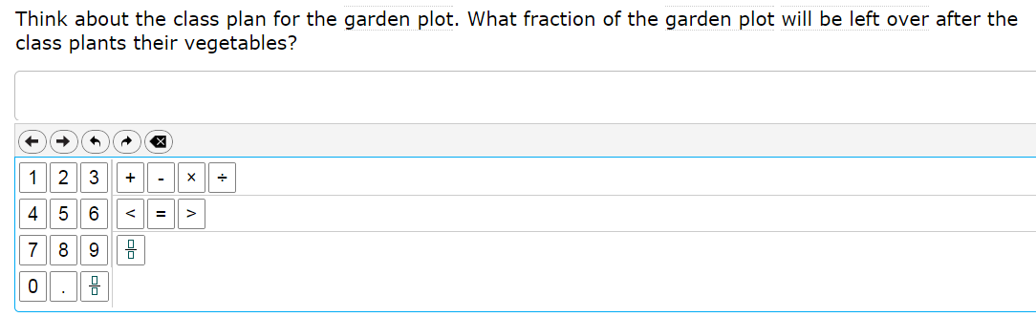
Example of a Performance Task
Smarter Balanced Practice Test; Grade 5 Math – Question 2
Notes:
The second question asks the student to compare the total area in the community garden against the total area that was planted to determine how much area is left for additional planting.

Slide 16
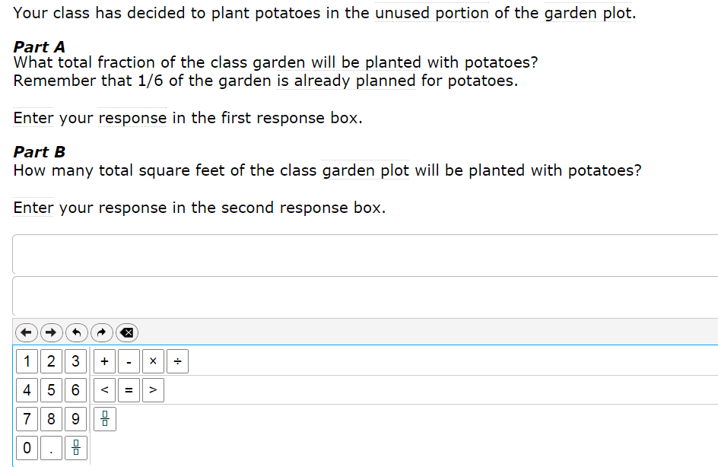
Example of a Performance Task
Smarter Balanced Practice Test; Grade 5 Math – Question 3
Notes:
The next step of the question states that the class has decided to plant potatoes in the unused portion of the garden plot, and asks the student to determine how much of the total plot will be planted with potatoes in fractions and in total square feet.

Slide 17
Components of the Performance Tasks
Combines knowledge and skills across multiple content strands within a content area
Reflects a real-world task or scenario
Usually multi-step
Requires
  Management of information and ideas
  Demonstration of 21st Century skills needed for college and career (critical thinking, analysis and synthesis of information from multiple sources)
Notes:
Clearly you can see that these type of performance tasks are much more involved that traditional test questions.
Performance tasks are designed as more in-depth experiences for students.
As often as possible they will reflect some sort of real-world example that is relevant and meaningful to students.
There are multiple steps to each performance tasks and often multiple correct solutions and/or strategies.
These are the tasks that really dig into the deeper thinking; they require students to manage information and ideas and consolidate them into a connected, understandable response.
You saw tonight an example for math.
There are also practice test examples for English-language arts. An English-language arts performance task might be given three sources of information and then asked to develop several research questions. Then they might be asked to write an essay integrating information from each of the three sources.
One way I like to think of performance tasks is that they measure a student’s deeper understanding of a concept or multiple concepts, it taps into their critical thinking skills and asks them to interact with information, sometimes presented in different formats, and come to a conclusion.

Slide 18
Spring 2014
Spring 2015
Field Test
Students tried out the technology and got familiar with new question types and the way that the testing system works.
No results because it was a “test of the test” or “trial run”
Operational Test
Results will be reported
  District-level
  School-level
  Student
Notes:
Ok, now that you are more familiar with the basics of the Smarter Balanced tests and have seen some of the new ways that students will be asked questions, let’s talk about how this year will be different from last year.
[Click]
[Click] Last spring was a field test which is a fancy way of saying it was a “test of the test” or a “trial run.”
Because it was just a “test of the test” scores were not produced for students.
[Click]
[Click] This year, all students in grades 3-8 and 11 will participate in the first operational administration of the Smarter Balanced tests in English-language arts and math.
And scores will be produced at the district and school level and also for individual students.
Those differences focus really on what the test was called and whether or not scores were reported. One of the most important things to remember is that students will be interfacing with the test in the same way as last year so the experience will be very similar for them. Last year’s practice made them familiar with the testing process.

Slide 19
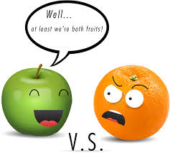
New Results
This year’s results will set a new baseline for progress students will make over time.
  Results can not be compared to prior years.
More information about results
will be provided in the future
– the California Department of
Education is still working out
final details.
Notes:
I think throughout the presentation tonight you can clearly see the dramatic differences between the old tests and the new tests.
And that leads us to this slide.
The differences are so dramatic that it’s critical to underscore that results can not be compared to prior years – these are new tests measuring new standards and the results are reported differently.
Comparing against prior year scores is like comparing apples and oranges. It isn’t a valid comparison.
Unlike STAR reports that showed five levels of student achievement (advanced, proficient, basic, below basic, and far below basic), these tests will provide different pieces of information.
Most importantly, results from this year will set a new baseline for student achievement.
More information will be available soon about the details of the new student score reports.

Slide 20

How Can You Help Your Child?
Discuss the new tests with your child. Make sure he or she is not scared or anxious about the new tests.
With older children, explain that the new tests were created to help him or her better prepare for college and career.
Explain to your child that the new tests will be more challenging for them, especially the first few times they take them.
Tell your child that you and his or her teacher have high expectations and that you are both there to help them every step of the way.
Review test results with your child, bringing your child’s teacher into the discussion as necessary.
Make sure your child gets a good night’s sleep and a nutritious breakfast before testing.
Source: National PTA “Parent’s Guide to New Assessments in California”
Notes:
Now to close out tonight’s presentation, this slide shows a that there are a variety of way that you can help your child do their best on this year’s test.
The suggestions on this slide were taken from the National PTA.
I think most would agree that we all do our best when we have had a good night’s sleep and a nutritious breakfast.

Slide 21
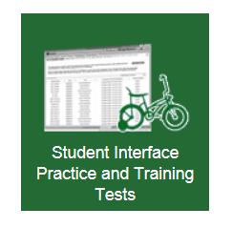
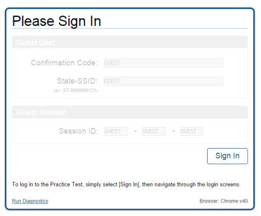
Take a Practice Test
The practice tests can be taken by parents, teachers, students, and others to review the type of test questions that students will see in different grades and subjects.
Practice tests are available at http://sbac.portal.airast.org/practice-test/.
  Once on the website above, click on the green box near the bottom of the screen that says “Student Interface Practice and Training Tests”
  Then click “Sign-in” on the next screen to get started.
  Select a grade and then follow the instructions.
Notes:
If you found the sample test questions interesting, then I’d suggest you log on to the website on this screen and take some more practice questions.
The practice questions will give you and your child a sense of the type of questions that they will see when they take the test at school.
Follow the directions on this slide to sign-in to the practice site.
Sometimes older versions of various Internet browsers don’t work very well. If one browser doesn’t work for you, try another one.
Once you sign-in you can choose between English-language arts and mathematics and you can also choose the grade level.
I like to start somewhere where I know I’ll be successful….like 3rd grade. But you can choose any grade you like.
The screen shots here will let you know if you are in the right spot.

Slide 22
Testing Schedule
Individual schools schedule their own testing dates within the dates above
Our District will test between XXX and XXX
More information about when your child will test will be sent home by his or her principal
Notes:
And finally, after all this information about the new tests you must be wondering when your child will take them.
Each district in the state is assigned a testing window.
Our testing window is between XXX and XXX.
Schools can select particular days within that window to test their students.
More information about when your child will take the tests will be sent home by your child’s principal or teacher.

Slide 23
For Further Information
[Your District’s Testing Department Name]
[Your District’s Testing Web page]
California Department of Education’s CAASPP Web page
http://www.cde.ca.gov/ta/tg/ca/
Frequently Asked Questions about CAASPP
http://www.cde.ca.gov/ta/tg/sa/sbcommonqa.asp
Parent Fact Sheet from Smarter Balanced
http://www.smarterbalanced.org/wordpress/wp-content/uploads/2012/03/Smarter-Balanced-Parents-Factsheet.pdf
Smarter Balanced Assessment Consortium website
http://www.smarterbalanced.org
Notes:
This slide gives you a few more places to go if you would like more information.
Thank you for coming tonight and I hope that I’ve been able to give you important information about this spring’s testing and answer questions that you had.

